Slide 1

Série sobre Inteligência Artificial
T3E7 – Optimizadores – 1.ª Parte
Gospel Fita,
Master finalist in Electrical Engineering – Signal Processing and Machine Learning,
Stellenbosch University
17 de Maio de 2025, Luanda

Slide 2
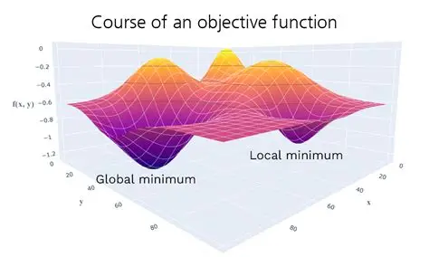

Slide 3

Standard Momentum
$Θ_{t+1}$ ${=θ}_{t}$ - $α$𝛻L
$Θ_{t+1}{=θ}_{t}\text{− }v_{t+1}$
$v_{t+1}$=𝜂$v_{t}$ - 𝛼𝛻L

Slide 4

Nesterov Momentum
$θ_{t}^{′}{=θ}_{t}$- 𝜂$v_{t}$
$v_{t+1}$=𝜂$v_{t}$ - 𝛼𝛻L($θ_{t}^{′}$)
$Θ_{t+1}{=θ}_{t}\text{- }v_{t+1}$

Slide 5
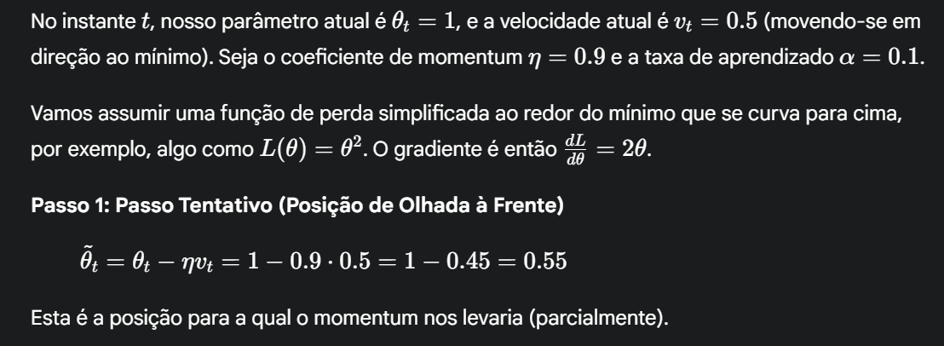

Slide 6
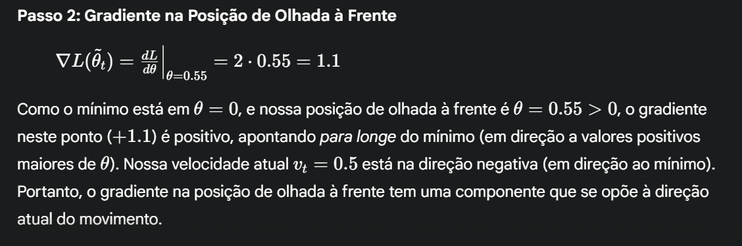

Slide 7
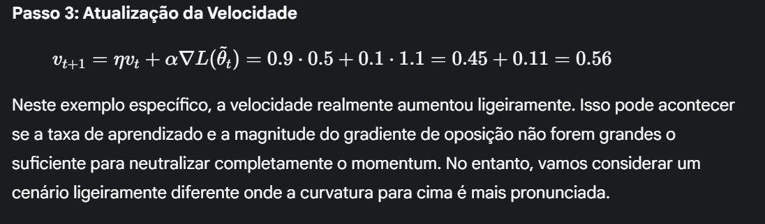

Slide 8
